Slide 1
Equity Trading Management
Mavez Singh Dabas
10BIT0245
Final Semester Project

Slide 2
POAD
Purpose
To acquaint ourselves with project Life-Cycle and Environment
To incorporate Team- Work
To be hands on with the various development Tools and Methodologies
Objective
To get accustomed with Real- Time Project Scenarios
To put in practice Sapient’s Development Methodology
Agenda
Project Life- Cycle
Team Structure
Technical Stack
Demonstration
Question and Answers
Feedback
Deliverables-
Equity Trading Management Demonstration

Slide 3
Project Duration
Building from scratch
Requirement Document
Additional Features
Project Organization
Use cases
Test Cases
Tracks Allotted
Unit Testing and Integration Testing
Defects Matrix

Slide 4
About the Project

Slide 5
Team Structure and Division
Portfolio Manager
Makes investment decisions using other people’s funds
Creation and management of Blocks.
Dashboard of Orders
Broker
Buys and sells shares and other securities through market makers or Agency Only Firms on behalf of investors
Tracks Leads
Quality Assurance
Scrum Managers
Track Leads
Quality Assurance
Scrum Managers
Execution Trader
Track Leads
Quality Assurance
Scrum Managers

Slide 6

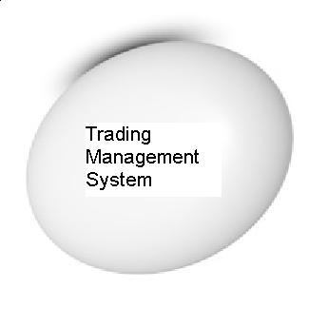

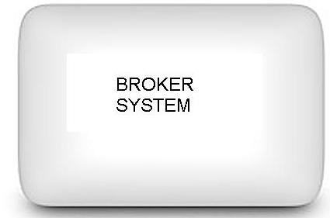






Context Diagram
Create order and send it to the trader
Create a block of order and put it in the Block queue
Portfolio Manager
Block Queue
Receives Executed Orders and Auto Allocates
Executes orders and stores in queue
Execution Queue

Slide 7
Portfolio Manager
View Current Positions
Filter the positions according to constraints
View Current Orders
Create Orders
Amend Orders
Send Orders to Trader for Execution

Slide 8
Execution Trader
View Blocks
Create Block
Add orders in existing blocks
Remove orders from existing block
Change limit price of a block
Filter the block according to constraints
Cancel a block
Send block for execution
Receives executions from Broker and processes the executions.

Slide 9
Broker System
Maintain configuration of various securities
Receive blocks from Execution trader
Performs execution process
Auto Allocates orders after receiving them from Execution Trader

Slide 10
Development Methodology Used

Slide 11
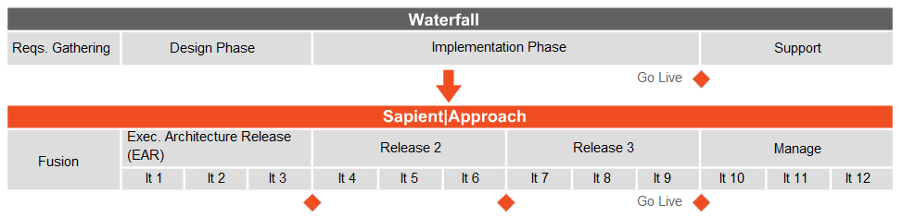
SAPIENT APPROACH
Prioritizing Customer’s time and requirements
Flexibility
Working Software at the earliest
Technical excellence and good design enhances agility

Slide 12
Technology Stack

Slide 13
TECHNICAL STACK
1.Development Tool (Visual Studio - 2010)
2. SQL Server Express
3. Presentation Layer – (WPF)
4. Middle Ware (WCF)
5. Miscellaneous (MVVM, EF, LINQ)
6. Quality Assurance(Manual)
7. Unit Testing And Integration Testing (N-Unit)
8. Defect Tracking (Result Space)
9. Change Management (SVN )

Slide 14
Demonstration

Slide 15
Quality Assurance Process

Slide 16
QA Process Followed
Stringent QA processes were followed
For Unit Testing - N Unit Test Cases
Defect Tracking done through Excel based tool
Test Cases were jotted down and Manual Functional Testing was performed
Attached here are the supporting documents
Defect Tracker –
Test Cases – Mock Project -

Slide 17
Learnings

Slide 18
Trading and Risk Management
Basics Of Financial Markets
Risk Management
Simulators
MARK IT
Moneybhai.com
Team Work
Common goals
Effective communication
Conflict Management
Efficient Delegation
Soft skills
Facilitation Skills
Presentation Skills

Slide 19
Challenges Faced

Slide 20
Code-Integration was a challenge
Applying SVN Tool in collaboration of the code, keeping it updated
Reaching Consensus
Applying the concepts learned

Slide 21

Questions

Slide 22
Feedback

Slide 23


Thank You !

